Slide 1
A Membership Benefit
Due diligence is complete on all endorsed suppliers to ensure:
Qualified products and services
Favorable pricing and term agreements for life science association members
Regular enhancement of agreement terms that follow industry trends
Benefits for members
Save money with best-in-the-industry rates
Save time with pre-negotiated terms and conditions
Increased purchasing power as part of a large customer base
Help and support the policy priorities of BIO and state associations

Slide 2
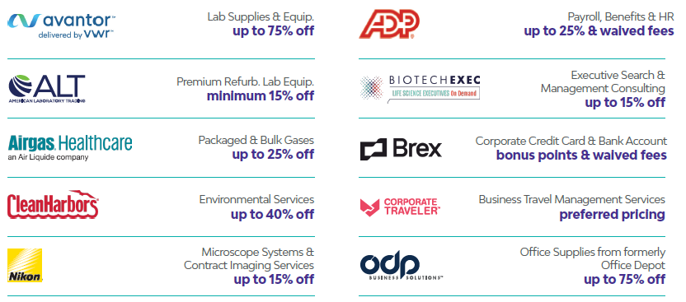
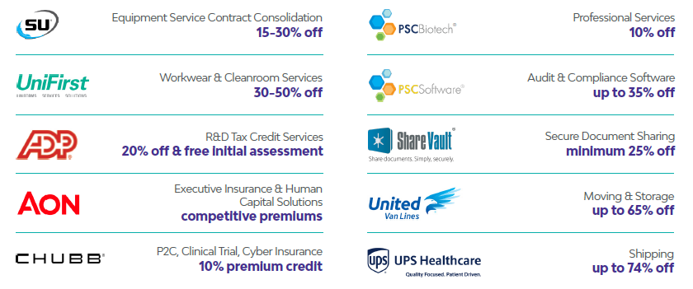
Sample Savings & Testimonials

Slide 3
Revenue and Savings
Ask the team for your customized revenue charts and savings data

Slide 4
Who Can Save
R&D life science companies
Life science companies without an in-house lab operation
Virtual labs
Start-ups
Technology companies
Companies that provide services to biotech companies
Companies that partner with CROs for research activities
Subsidiary of a company headquartered outside the US

Slide 5
Lab & Facilities
Packaged/bulk gas, Airgas
Refurbished lab equipment, ALT
Lab supplies, Avantor (VWR)
Waste removal, Clean Harbors
Microscope systems & contract imaging services, Nikon
Equipment service contract consolidation, SU Group
Cleanroom and First Aid Safety, Unifirst

Slide 6
HR & Insurance
All-in-one HR, ADP
R&D Tax Credits, ADP
Compensation surveys, Workforce benchmarking, Aon
D&O, Executive Liability, and Cyber insurance, Aon
Business, Property & Casualty, Clinical Trial insurance, Chubb

Slide 7
Corporate Services
C-Suite executive consulting & placement, BiotechExec
Corporate credit card & expense management, Brex
Business travel management, Corporate Traveler
Office supplies, printing, ODP Business Solutions
(formerly Office Depot)
FDA/regulatory consulting services, PSC Biotech
Quality management software, PSC Software
Secure document sharing, ShareVault
Office and employee relocation, United Van Lines
Shipping & logistics, UPS Healthcare

