Slide 1
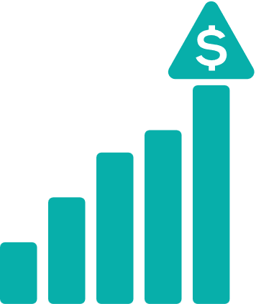
BBS by the Numbers
We can create a customized slide with your data.
$830 M
$633 M
TOTAL ANNUAL SPEND
AGGREGATE SAVINGS IN 2023
4,600
6,090
COMPANIES PARTICIPATING
BBS PROGRAMS USED
AstraZeneca, Biogen, BioMarin, Bristol Myers Squibb, Genentech, Gilead Sciences, GSK, Incyte, Lonza, Merck, Moderna, Novartis, Novo Nordisk, Pfizer, Regeneron, Sangamo, Vertex, and more.
Participating Companies

